Slide 1

Sprint 2: Sports Betting With Data Science
By Justin Tunley

Slide 2
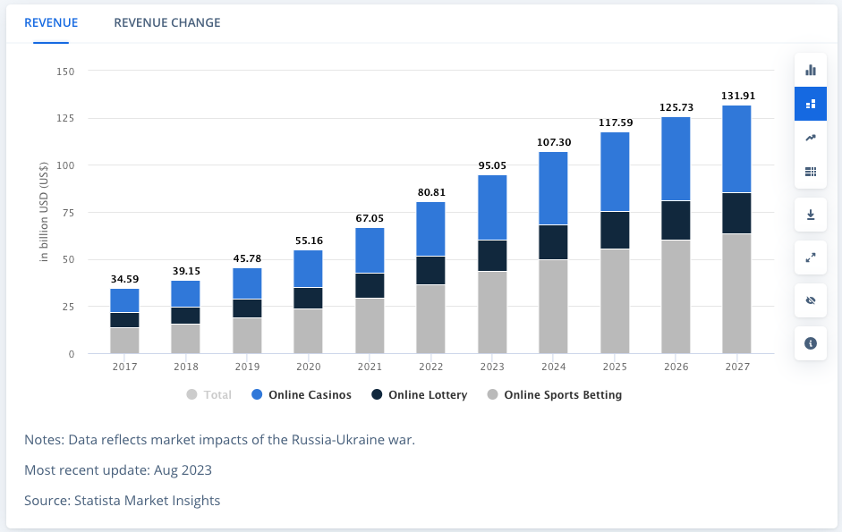
Problem Statement, Opportunity and Impact
Problem Statement
Can we use team analytics to make predictions on future NFL games?
Opportunity
Online Sportsbook: Create accurate lines that can help you make money
Household Bettors: Beat the system by finding advantageous bets
Sportsbooks must adjust for user betting trends. You do not, giving you an opportunity to beat the system.
Impact
MPM – Make People Money

Slide 3
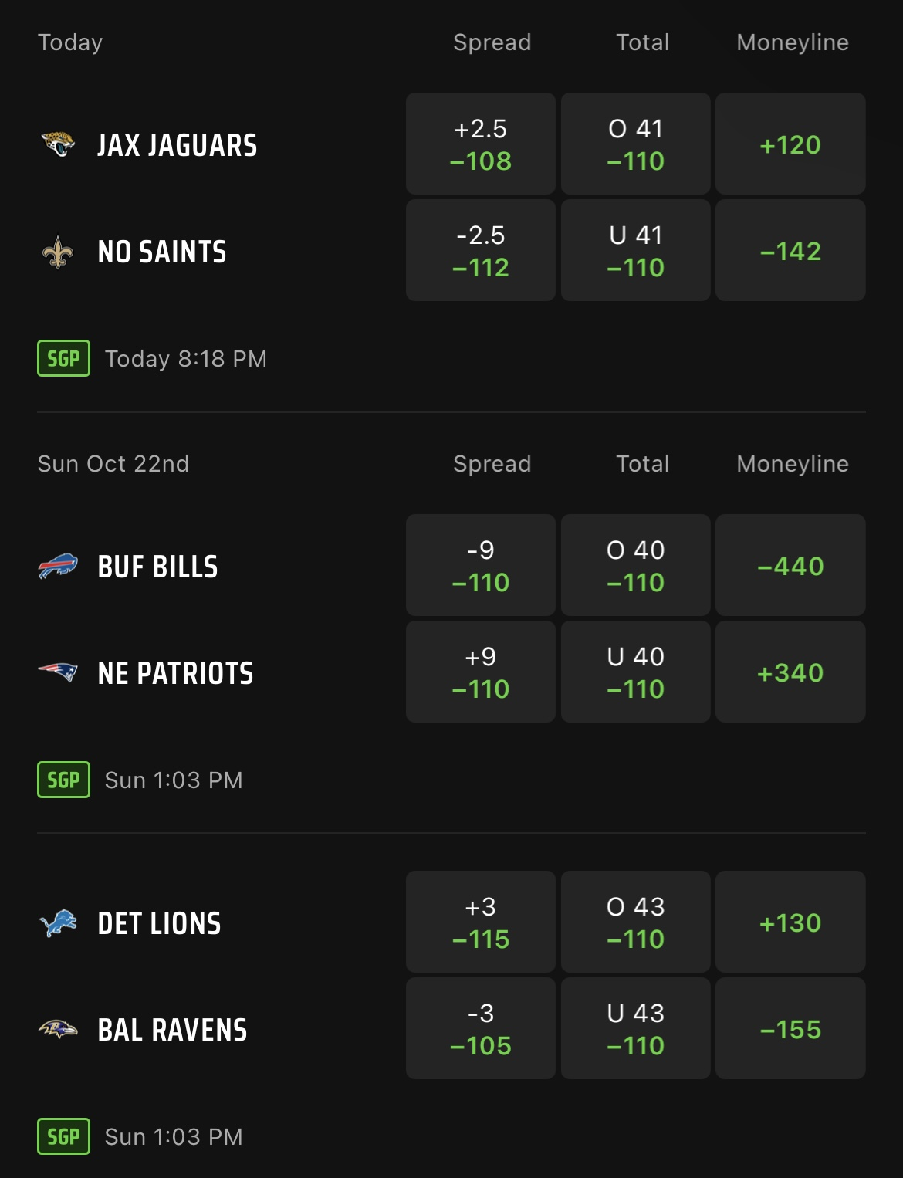
(Re)-Intro to Sports Betting
Key Terms
Moneyline: Who will win?
Compare expected points between home and away teams.
Spread: How much should the favored team win by?
The difference in expected points between teams.
Point Total (O/U)
The sum of expected points for both teams.
Solving with Data Science
2 Regression models:
Home Offense vs Away Defense --> Home Team Expected Points
Away Offense vs Home Defense --> Away Team Expected Points

Slide 4
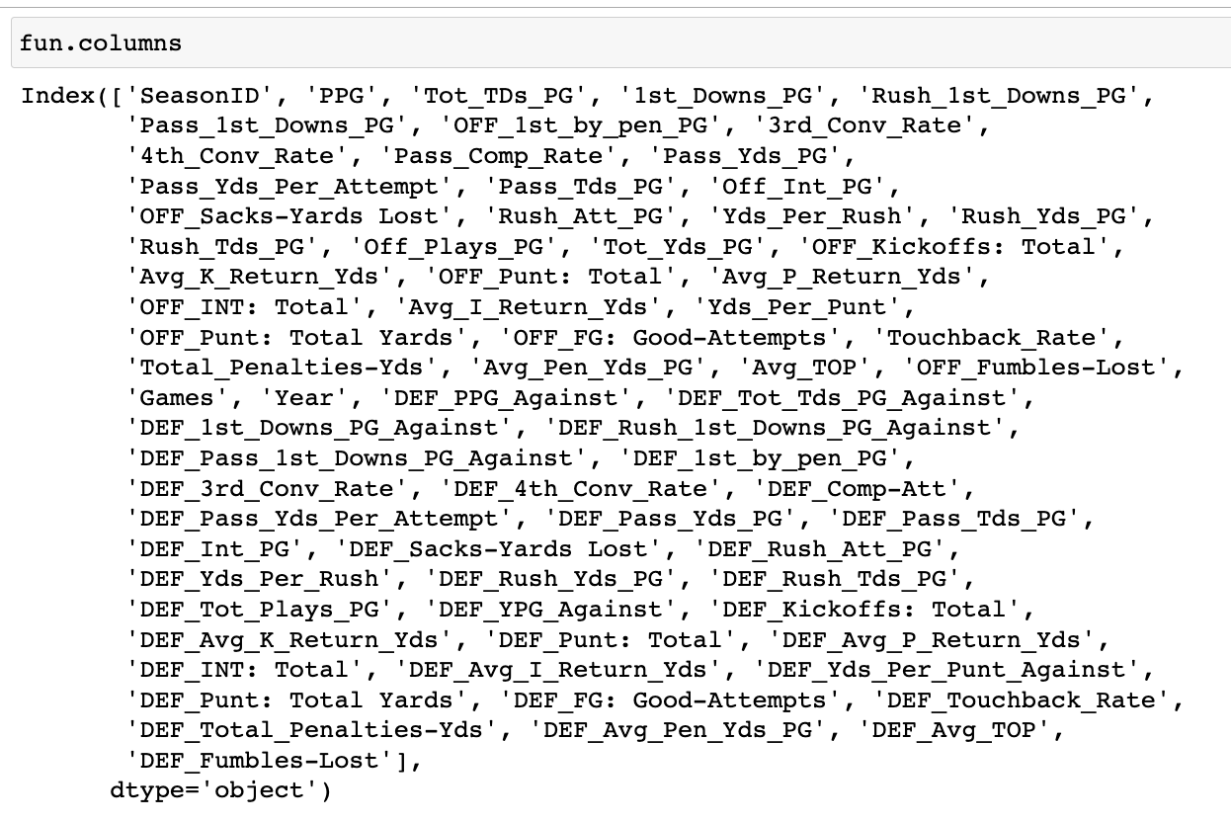
Datasets and Preprocessing (Set 1) – Off/Def
Scraping from ESPN (Season-Long Data)
Create a for-loop cycling through ESPN hyperlink.
32 teams x 19 seasons x 2 rows per season (playoffs not included)
Off and Def are two separate rows. Split DF and rejoin along season index.
Feature Engineering
Create a column for number of games.
85 Features ---> 70 Features (1 of 4 options)
Drop columns that are redundant (i.e., OFF_Games and DEF_Games)
Divide columns with ‘yearly totals’ by # of games (season points → PPG)
Split columns into two new columns for more information (Kicks-Yds) → (Kicks), (K_Yds)
Leave ratios as is.
All columns were renamed, and defensive features begin with ‘DEF_’

Slide 5
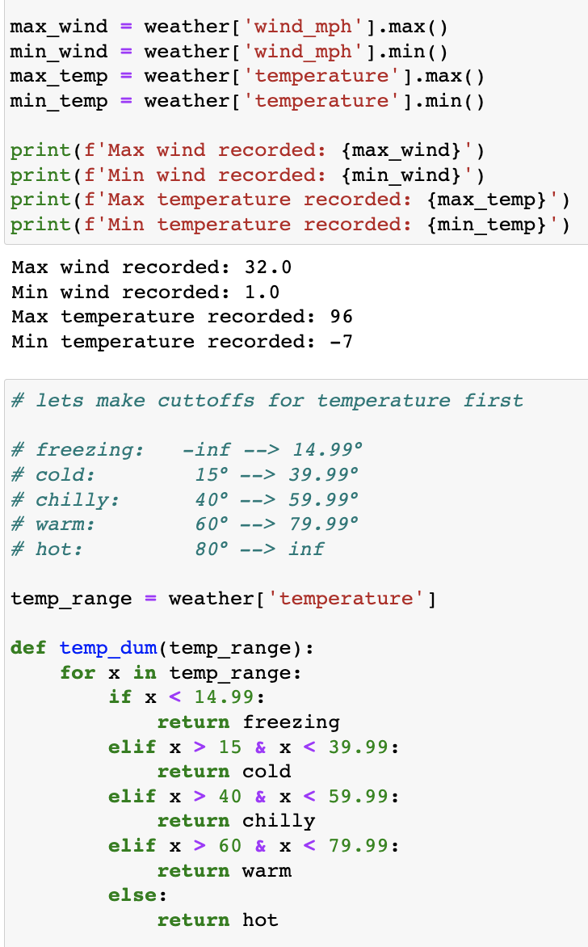
Datasets and Preprocessing (Set 2) – Weather
Importing from Pro Football Reference (Ind. Game Data)
Fairly clean on import
Dating back to 1960 so some teams don’t exist anymore, but this won’t matter for our objective.
Feature Engineering and Dummying
Home Points + Away Points = Total Points
3 columns that must be dummied:
Temperature, Wind (mph), Humidity
Create ranges for each and dummy to determine how each affects total points.
Final Goal
Find coefficients for each data type and range, which can be added to my findings from DF1 to create even more accurate predictions.

Slide 6
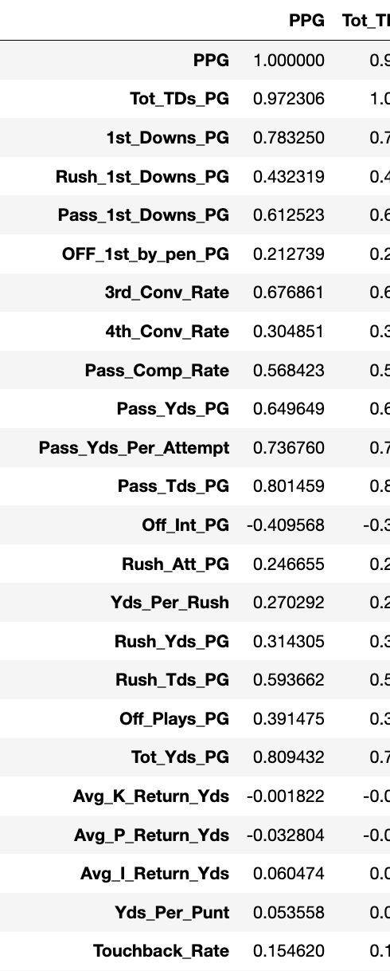
Exploratory Data Analysis
Interesting Takeaways
Do rushing or passing metrics have a higher impact on expected points?
Which types of turnovers are more detrimental to a team?
Does special teams still matter in the NFL?
Want to Learn More:
These are questions I want to pursue but need more to answer…
Does weather affect certain teams more than others? Is there a way to quantify this?

Slide 7
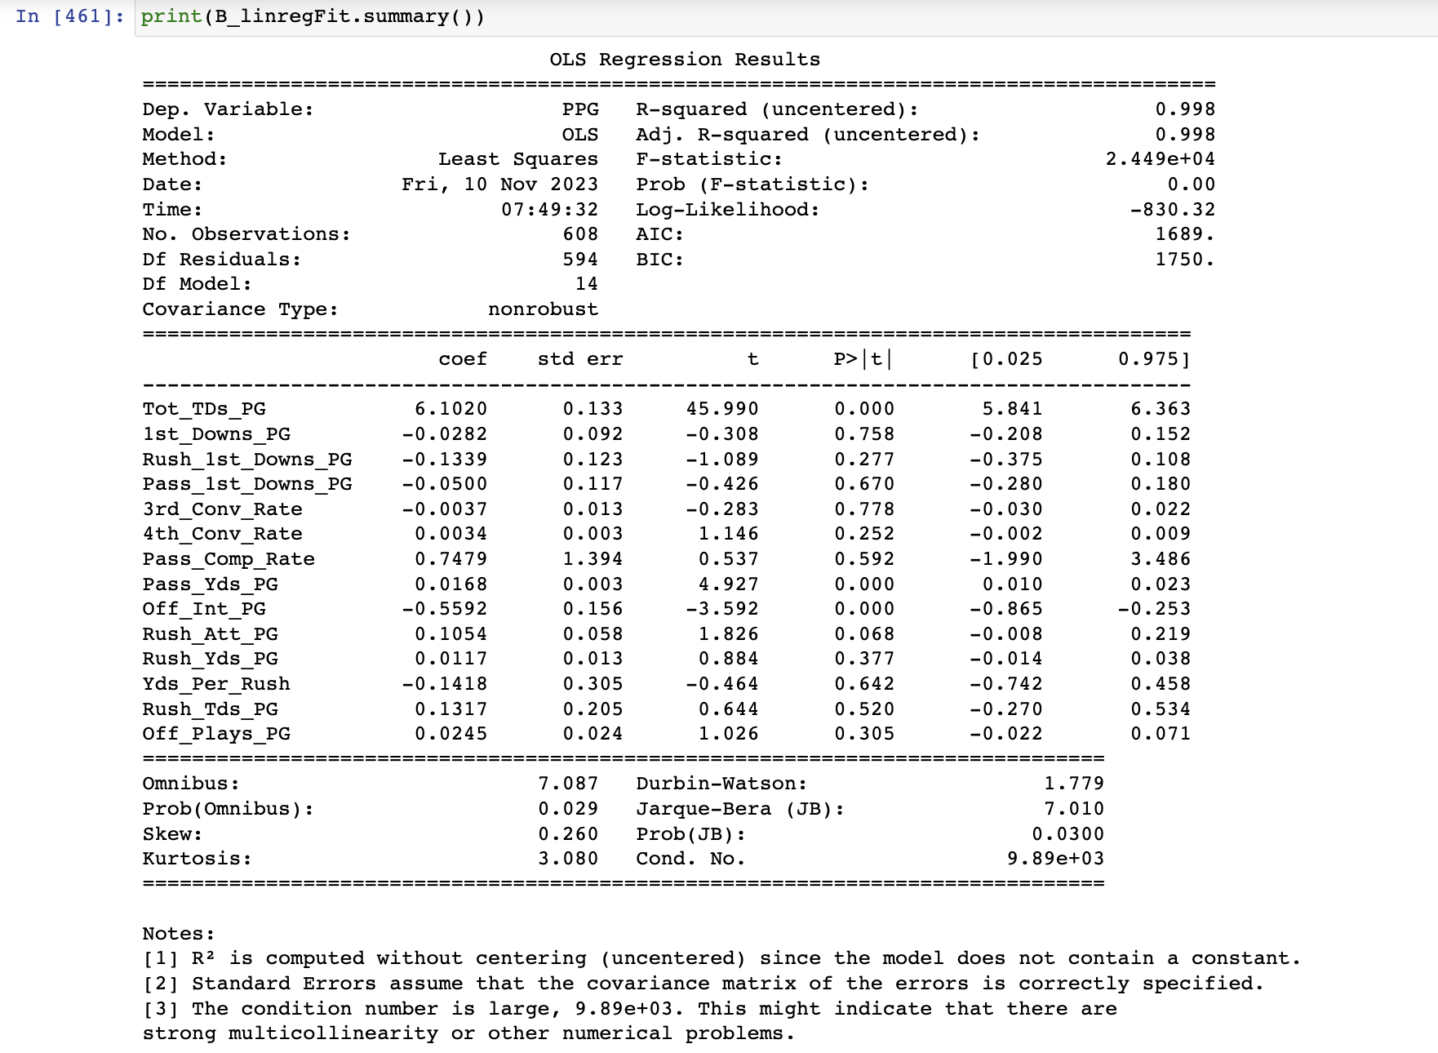
Preliminary Modeling
Logistical Regression
Error: ‘Endog must be in the unit interval’
Attempts to run with less features still create problems…
Let's try a linear model.
Linear Regression
Adj R-squared = 0.998
Really high…. Like way too high
Potential problems:
Overfitting – too many features
Too much correlation between features
Probable solution:
Neural Network

Slide 8

Next Steps
Gameplan
Step 1: Neural Network on my clean data.
Step 2: More data (tendencies, redzone conversion, players)
Step 3: Incorporate weather data (Meteostat API)

